Slide 1
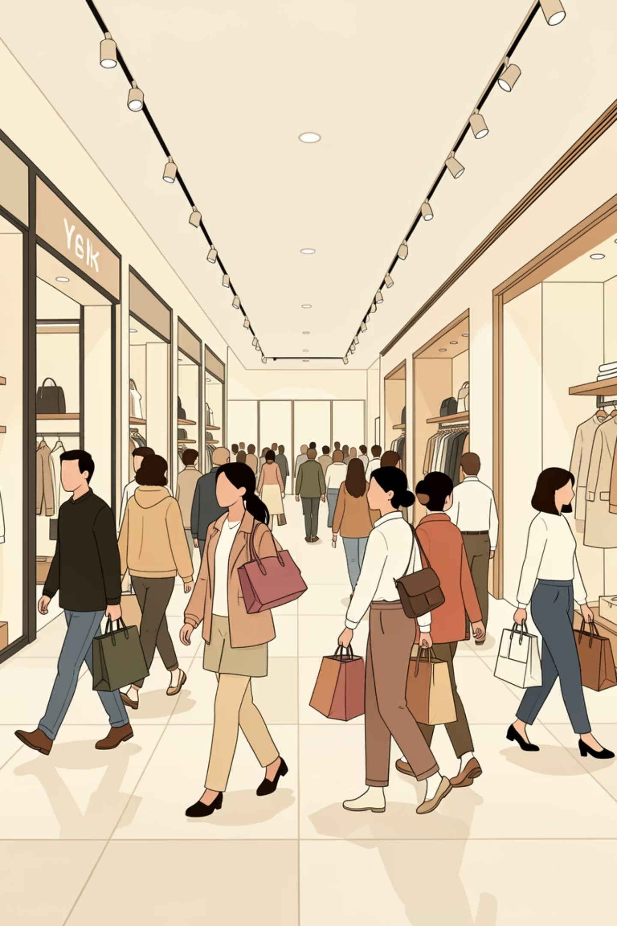
Customer Shopping Behavior Analysis
This project analyzes customer shopping behavior using transactional data to uncover insights into spending patterns, customer segments, product preferences, and subscription behavior. Our goal is to guide strategic business decisions.

Slide 2

Project Overview & Dataset Summary
Project Goal
Dataset at a Glance
Uncover insights from 3,900 purchases to inform business decisions regarding spending, segments, product preferences, and subscriptions.
Rows: 3,900
Columns: 18
Key Features: Demographics, purchase details, shopping behavior.
Missing Data: 37 values in Review Rating.

Slide 3

Exploratory Data Analysis: Python
We initiated our analysis with data preparation and cleaning using Python.
1
2
Data Loading & Exploration
Missing Data Handling
Imported dataset with pandas, checked structure with df.info(), and summarized statistics with .describe().
Imputed missing 'Review Rating' values using the median rating per product category.
3
4
Column Standardization
Feature Engineering
Renamed columns to snake_case for improved readability and documentation.
Created age_group by binning ages and purchase_frequency_days from purchase data.

Slide 4


Data Analysis: SQL Insights
Structured analysis in PostgreSQL answered key business questions.
Revenue by Gender
Top 5 Products by Rating
Shipping Type Comparison
Female: $75,191, Male: $157,890.
Gloves (3.86), Sandals (3.84), Boots (3.82), Hat (3.80), Skirt (3.78).
Standard: $58.46, Express: $60.48.

Slide 5

SQL Analysis: Customer & Product Focus
Subscribers vs. Non-Subscribers
Discount-Dependent Products
Subscribers (1053): Avg Spend $59.49, Total Revenue $62,645.
Hat: 50.00%
Non-Subscribers (2847): Avg Spend $59.87, Total Revenue $170,436.
Sneakers: 49.66%
Coat: 49.07%
Sweater: 48.17%
Pants: 47.37%

Slide 6
SQL Analysis: Customer Segmentation
We classified customers into distinct segments based on their purchase history.
New
83 Customers
Returning
701 Customers
Loyal
3116 Customers

Slide 7
SQL Analysis: Product Performance
Top 3 products within each category based on total orders.
1
Accessories
Jewelry
1
Clothing
Blouse
1
Footwear
Sandals
1
Outerwear
Jacket

Slide 8
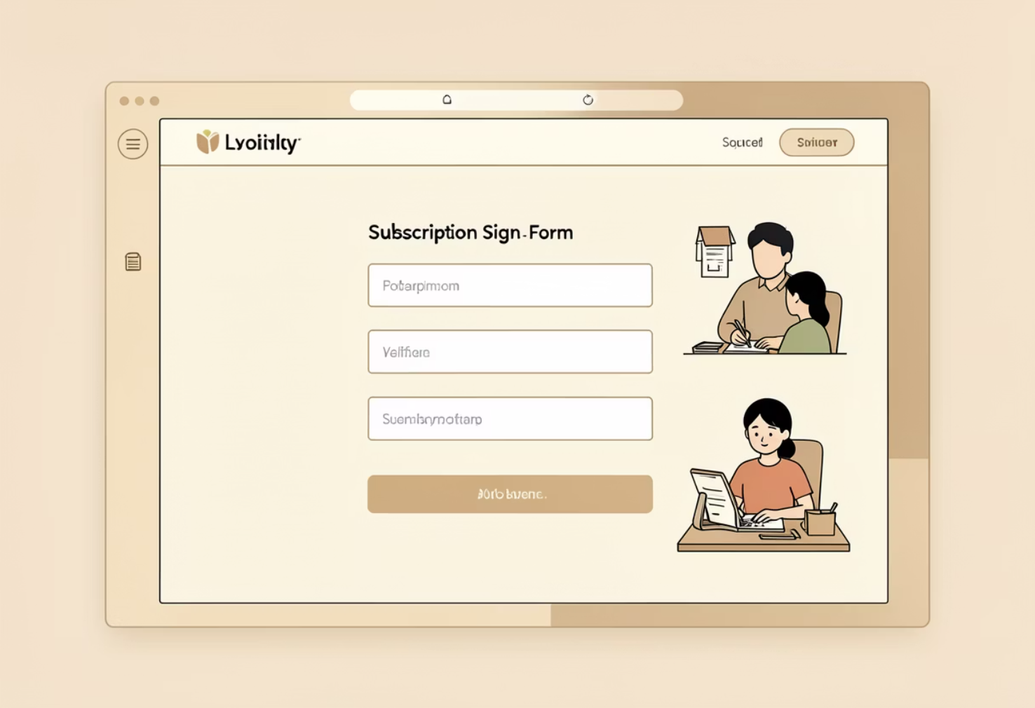

SQL Analysis: Age & Subscriptions
Repeat Buyers & Subscriptions
Revenue by Age Group
Customers with >5 purchases:
Young Adult: $62,143
No Subscription: 2518
Middle-aged: $59,197
Yes Subscription: 958
Adult: $55,978
Senior: $55,763

Slide 9
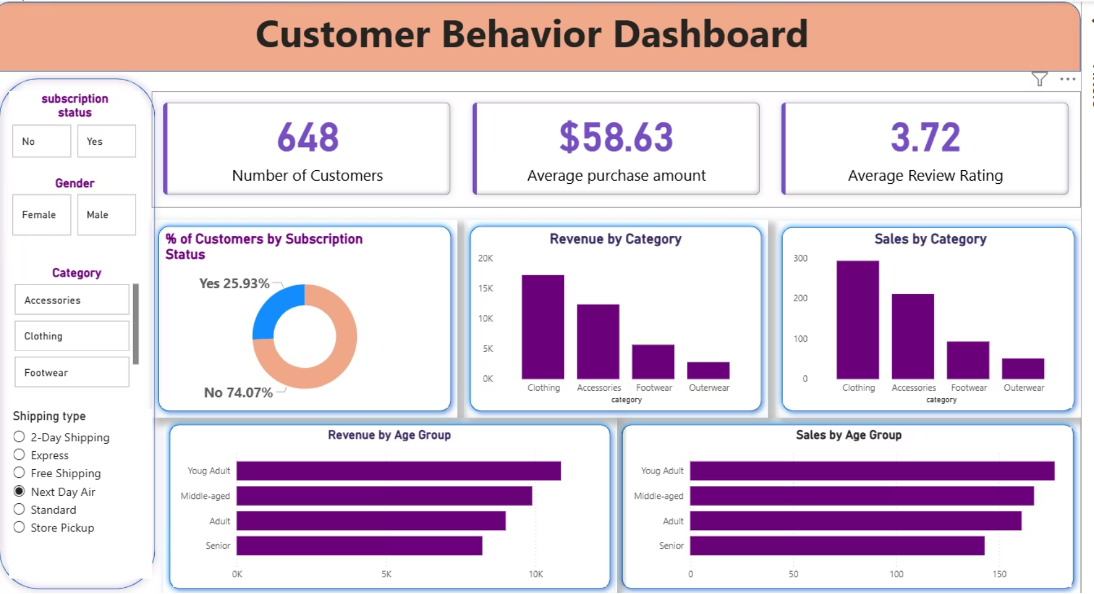



Power BI Dashboard: Visualizing Insights
Our interactive Power BI dashboard provides a visual summary of key metrics and trends:
3.9K
$59.76
3.75
Number of Customers
Average Purchase Amount
Average Review Rating

Slide 10





Business Recommendations
Boost Subscriptions
Promote exclusive benefits to increase subscriber base.
Customer Loyalty Programs
Reward repeat buyers to foster loyalty and retention.
Review Discount Policy
Balance sales boosts with careful margin control.
Targeted Marketing
Focus efforts on high-revenue age groups and express-shipping users.

